Slide 1
CDC DATA ANALYSIS Navroze Mishra

Slide 2
Introduction
DATASET:
Dataset - CDC dataset pertaining to death rates across the country
AIM:
To extract meaningful insights and detect trends from data visualizations about gun related deaths
To detect socio demographic patterns from analysing the dataset
To develop a moderately accurate predictive model that can identify individuals who are more likely than other persons to engage in this form of violence.

Slide 3
Technical details
Tools Used:
Data Storage - AWS S3
Data Visualization - Tableau
Modelling - Pyspark
Pre-processing:
Standardized the education recode
Dropped columns which have more than 70% of missing data

Slide 4
Visualizing the data

Slide 5
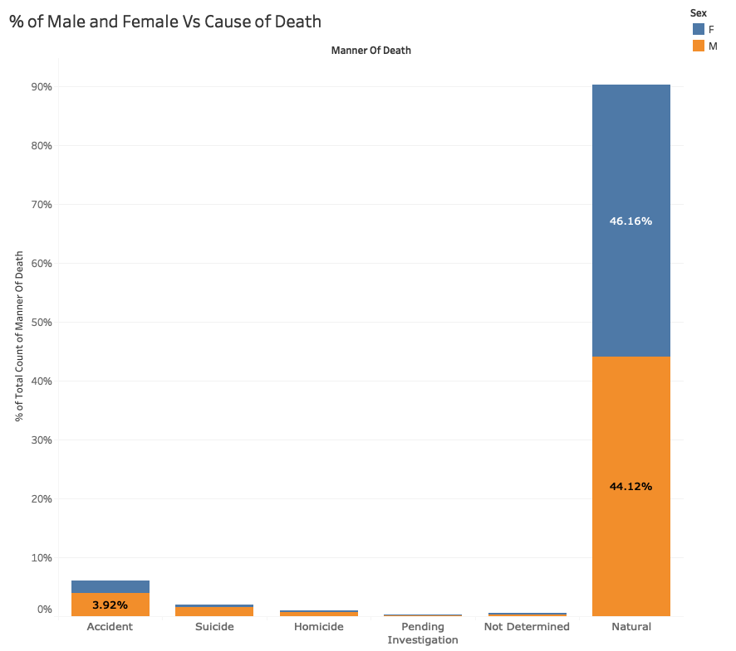
Percent of Male and Female deaths
Approximately twice the number of men die via accidents when compared to women
The number of men committing suicide is about four times the number of women committing suicide.

Slide 6
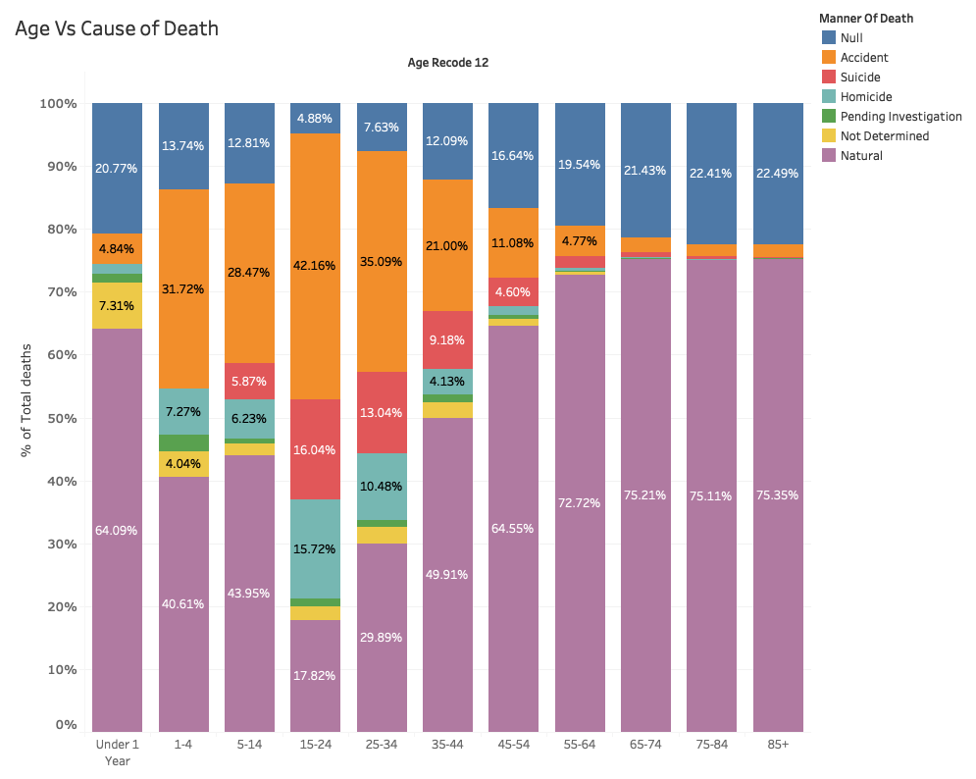
Age versus cause of death
About 42% of people between 15-24 died due to accidents
Highest number of suicides and death by homicides is also seen among this group
This group also has the least number of natural deaths

Slide 7
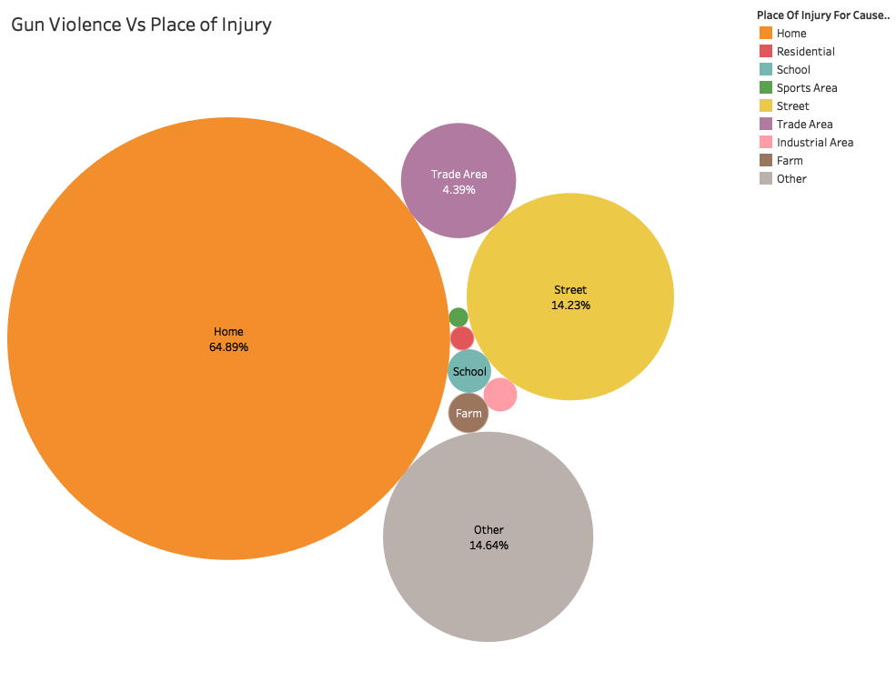
Gun violence vs place of injury
Alarming amount of 65% gun violence deaths happen at Home
43% of total gun assaults also took place at home

Slide 8
Education vs type of death
People who did not complete college is 2.5 times more likely to suicide by a gun than get assaulted.
Lower the education level higher the chances of dying by gun assault

Slide 9
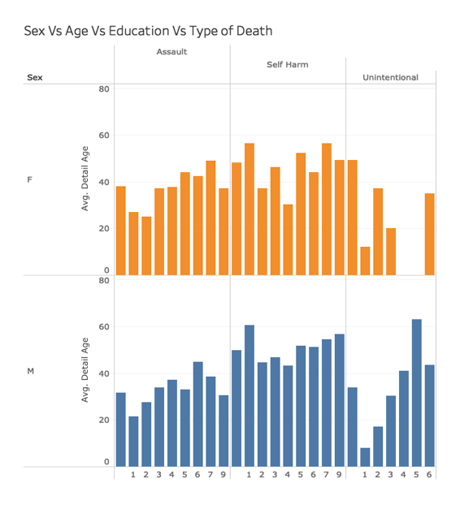
Sex vs Education vs Age
The average age of male whose education level is less than 8th grade dying in a gun assault is 21.58
The average age of female whose education level is less than 8th grade dying in a gun assault is 27
The average age of death due to Unintentional causes in males and females whose education level is less than 8th grade is 12 and 8

Slide 10
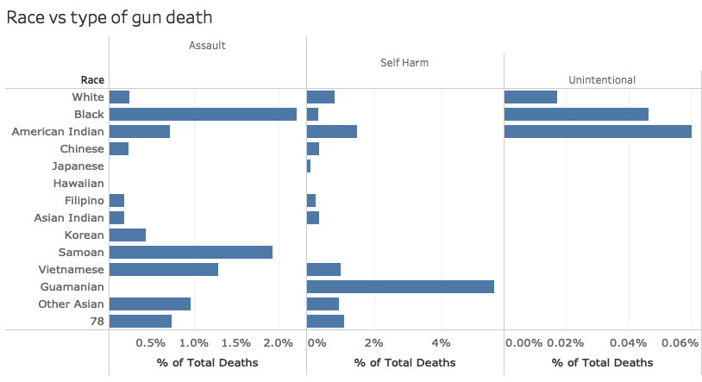
Race vs type of gun death
The average African American is 9 times more likely to be a victim of gun assault than a white American

Slide 11
Predictive modeling

Slide 12
Model summary
Important Features:
Sex
Race
Marital Status
Age
Final model statistics:
MODEL TRIED | ACCURACY
Logistic Regression | 62%
Decision Tree | 60%
Random Forest | 71%
AUC | 0.65
Accuracy | 71%

Slide 13
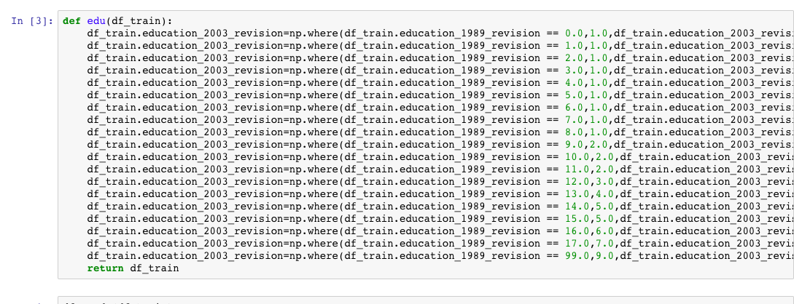
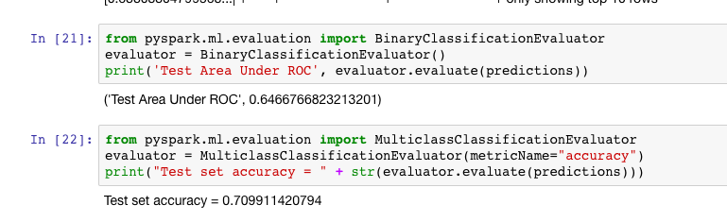

Slide 14
Recommendations
1. Suicide Prevention Awareness must be spread amongst men and special assistance must be provided to those suffering from mental illness.
2. Police patrolling must be increased between the months of May-July.
3. Stricter gun regulation measures must be enforced.
4. Incentivise education, as there is a correlation between gun related deaths and education.

Slide 15
Further scope of improvement
Use dynamic features instead of static features.
for example, unmet mental health needs for conditions linked with violence to self (such as depression) or others (such as paranoia), lack of mental health care, abuse of alcohol — are more amenable to intervention and treatment that can reduce the risk for gun violence

Slide 16
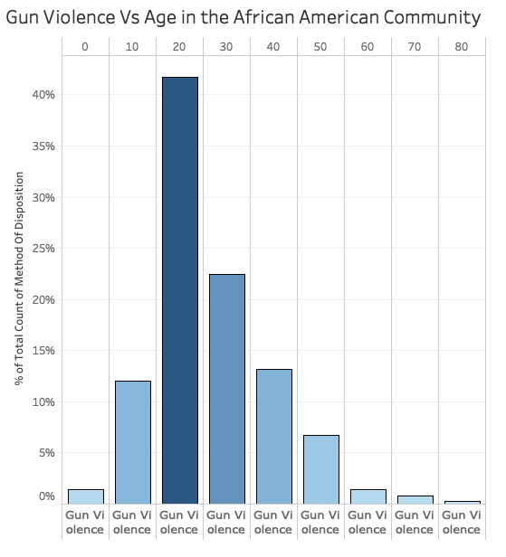
Gun Violence Vs Age in the African American Community
About 45% of gun violence deaths occur among the 20-29 year old category
Deaths due to gun violence is almost negligible among people in the 70+ age group

Slide 17
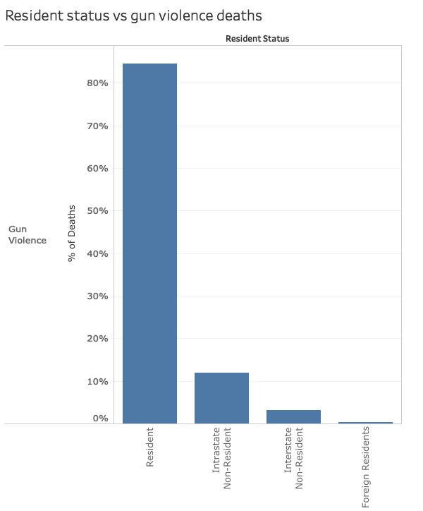
Resident Status Vs Gun Violence Deaths
85% of people killed in gun violence deaths are residents
No of foreign residents killed are negligible

Slide 18
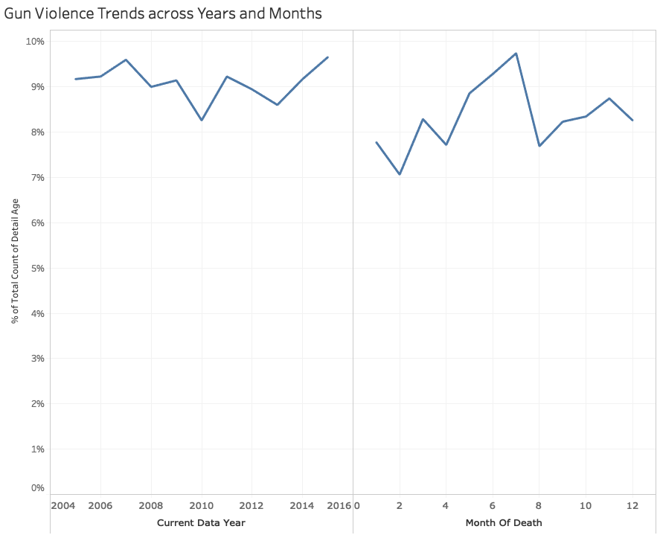
Gun Violence trends across Years and Months
The average African American is 9 times more likely to be a victim of gun assault than a white American
Guamanians inflict self harm by gun at a rate which is 10x higher than the National average.

Slide 19
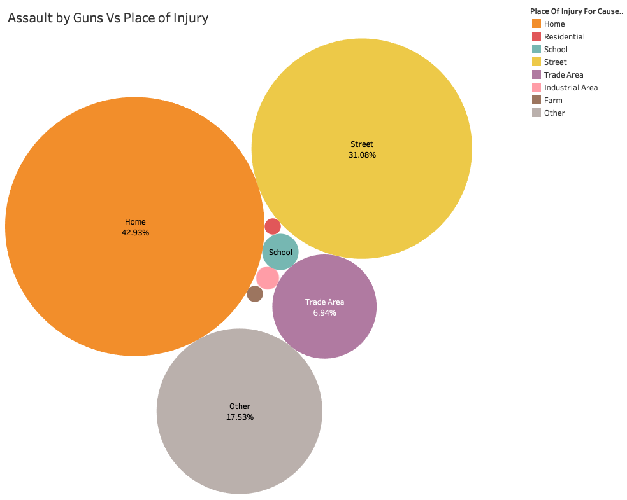
Assault by Guns Vs Place of Injury
An enormous amount of gun assaults 43%, happen at home
Streets have the second highest number of gun assault cases

Slide 20
MODELLING
Data Cleaning
Merged the education levels using pandas
Handled null values and dropped unimportant columns
TABLEAU LINK
By leveraging tableau EMR Hive connector, established connection with hive external table.
Using Tableau, gained insights on the dataset.
DATA STORAGE
Downloaded data from Kaggle
Uploaded the .csv files to S3 storage
Used Pig to load the files into HDFS
DATA PRE-PROCESSING
Stored this csv file into Databricks
Split data into test and training
Started pyspark modelling
Ran multiple algorithms and found Random Forest to be the best

